Slide 1









Investigating Systemic Racial Bias in Public funded Services in the Great City of St. Louis, MO

Slide 2
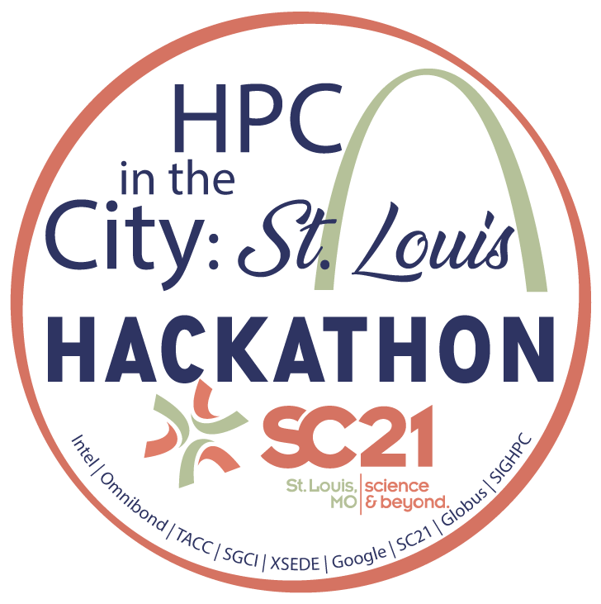
Investigating Systemic Racial Bias in Public funded Services in the City of St. Louis
Munene Kanampiu (WSSU Computer Science Faculty/Hackathon Mentor)
Winston-Salem State University
Email: kanampiumw@wssu.edu
Rebecca Caldwell (WSSU Computer Science Faculty/Hackathon co-mentor)
Email: caldwellr@wssu.edu
Project Idea: Does there exist racial bias in allocation of public-funded services in the great city of St. Louis? (Sample data examples: Public saftey,Public health, Public education)
Impact: Racial Injustice Awareness for the residents of St. Louis & greater Missouri state
Possible HPC Resources: Assorted from Google Computing/Cloudy cluster platforms
Python,Jupyter notebooks, HTML, Google sheets?
Data science: Data Set Links portal https://rdx.stldata.org/search/type/dataset

